Slide 1


Determining similarity between NEW YORK CITY and TORONTO
Rituparna Chatterjee

Slide 2
Problem statement
Comparing most common venues grouped by unique categories in the neighbourhoods of New York and Toronto city , determine the similarity between these neighbourhoods.
Background
New York and Toronto, two major cities of the world. Lots of businesses and companies have their head offices in and around these cities, which urges lots of people from around the world from different professional background to come and settle here. Additionally, many people have to move among these two cities too, i.e., New York to Toronto or vice versa for job requirements or business needs. Suppose if a resident of New York has to permanently move to Toronto and he/she is searching for a place to live there. That person would like to move to similar area as their current area in New York based on nearby venues including coffee shops or schools or parks or types of restaurants, etc. And also for new comers as both cities are very diverse and are the financial capitals of their respective countries it will be helpful for someone wanting to choose between these two places for having an ideal place to live where he or she can compare things like community culture, good educational institution, hangout places etc.

Slide 3
Data Acquisition
Urls for New York and Toronto data are respectively https://cocl.us/new_york_dataset , and https://en.wikipedia.org/wiki/List_of_postal_codes_of_Canada:_M.
Firstly the data will be collected for all the neighbourhood areas in NEW YORK AND TORONTO with the help of the URLs shared with us in this course .
Then the latitude and longitude data for all those neighbourhoods will be collected using Geocode pyhton package.
Libraries used in this project: Pandas, Numpy for easy data manipulation and analysis, Sklearn for machine learning algorithm here K-Means algorithm, Folium for data visualisation.

Slide 4
Data Cleaning
For simplification in analysis the New York data is converted to only Manhattan data by extracting only Manhattan boroughs from this dataframe.
In the Toronto data table scraped from the web mentioned earlier, the NULL rows were dropped, same postal code neighborhoods were grouped in one row and then postal code column was dropped.
These two city’s dataframes were concatenated.
Foursquare API calls were made to get top 100 most important venues of each neighbourhood.
The venues were grouped by their categories and finally for each neighbourhood top 10 most common venue categories were selected.
Finally the refined cleaned and ready for future analysis dataset is formed.

Slide 5
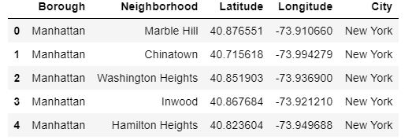
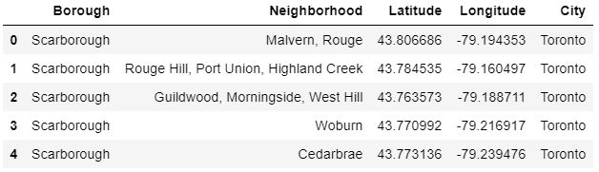
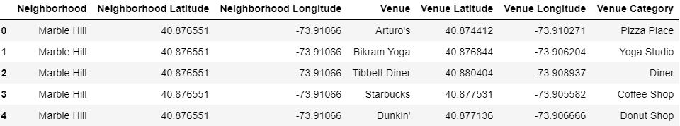
New York/ Manhattan dataframe
Toronto dataframe
Resulting dataframe after merging these two above dataframes and extracting top 100 venues in all their neighbourhoods

Slide 6
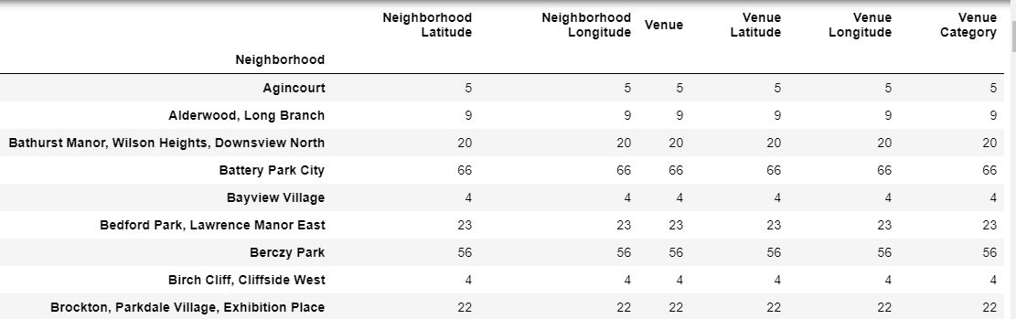
Each neighbourhood was grouped to see how many venues are there for each neighnourhoods. For Agnicourt there are 5 different venues.
There are 391 unique categories curated from all the returned venues.

Slide 7
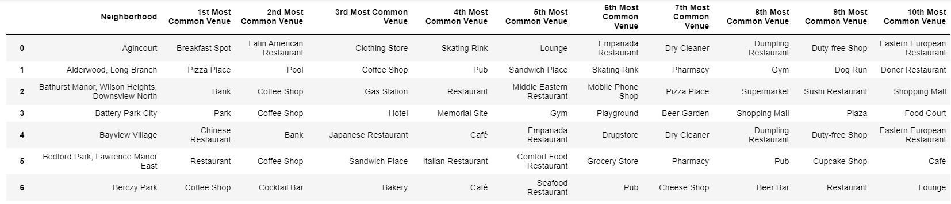
This new dataframe displays the top 10 venues for each neighborhood.

Slide 8
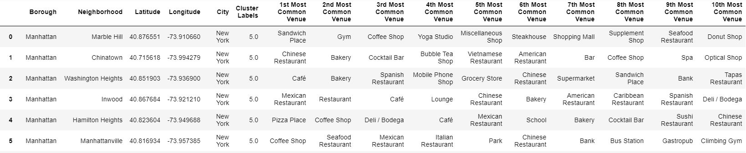
After k-means algorithm , each neighnourhood was given a cluster number, here shown neighbourhoods belong to cluster 5.

Slide 9
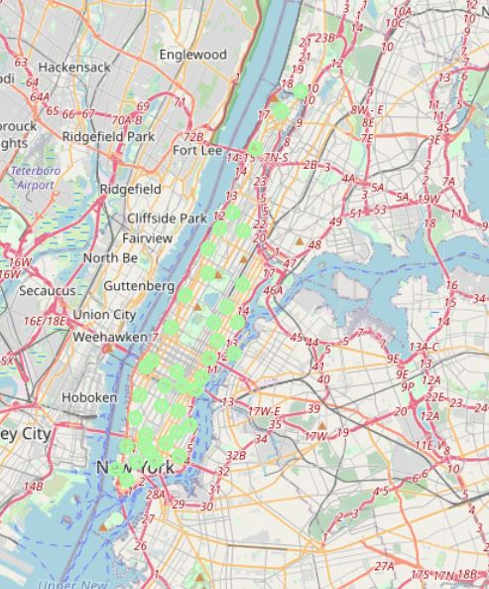
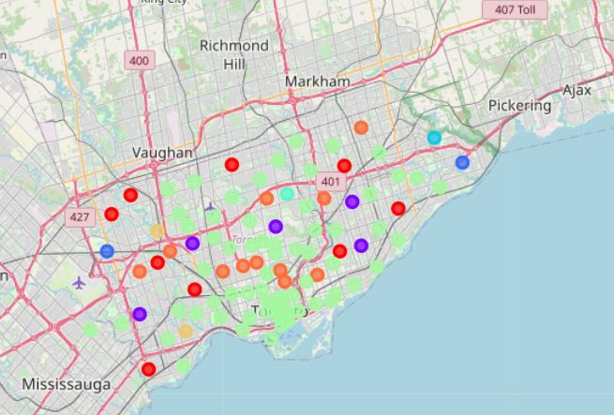
Maps showing clustering in New York and Toronto city
New York cluster map
Toronto city cluster map
Here lights green color circles showing neighbourhoods in cluster number 6

Slide 10
Results and Discussion
All New York / Manhattan neighbourhoods were clustered into only one group, although by increasing the number of clusters in the Kmeans algorithm we will find different clusters in the New York neighbourhoods too.
Here for K=8 , cluster 6 include all the neighbourhoods in New York and some neighbourhoods from Toronto. The 1st common venues in this cluster neighbourhoods are cafes, fine dinning continental restaurants, grocery stores etc. So if someone wanting to switch places between New York and Toronto ,they should look for places in the neighbourhoods from cluster 6 to get a similar feelings with their current location after shifting .
Cluster 1 includes neighbourhoods having good pizza place nearby.
Cluster 2 neighbourhoods have mostly breakfast places, bakery shops etc.
For drugstore , women's store cluster 3 neighbourhoods are ideal.
Cluster 4, cluster 5 and cluster 7 have very less number of neighbourhoods , so these places are outliers in clustering distribution.
Cluster 6 includes the most happening places in these two citys , here one can find amazing nightlifes with excellents chinese, italian, mexican restaurants and bars, nice coffee shops, supermarkets etc. Cluster 8 mainly group places with playground, many kind of sports arena ,parks etc.

Slide 11
Conclusion
The objective of this project was to find similar neighbourhoods in New York and Toronto by applying K-means clustering algorithm in their neighbourhoods and grouping then based on some discriminating category. From the visualisation of the result we can see that we weren't able to cluster places within New York, this is because of very large number of input data and less number of the assumed K value in this algorithm. Although we were able to find the most similar places in these two cities, that is neghbouhoods from cluster 6.

